Slide 1
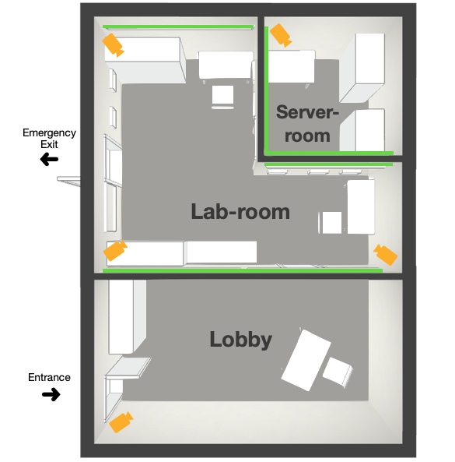
Players enter through Door 1 (programmable magnetic lock)
Motion sensor: to detect the entry of all players
Announcement through speaker (NASA warning)
Environment - Emergency lights flickering
Puzzle 1
Puzzle: Decoder box to open safe box (Key inside safe box) – Code is the date of the event
Result: Key/RFID tag to open Door 2
Enters Lab room –
Stable LED lights
Timer displays time left
Penalty leads to decrease in time and LED lights flicker
Door 4
Puzzle 4
Puzzle 5
Door 3
Puzzle 3
Puzzle 2
Door 2
Door 1
Puzzle 1

Slide 2
Puzzle 2
Audio detection (piano high low concept)
Result: Code (Binary) to Door 3
Puzzle 3
Joystick & Blacklight: “Code is the key to Door 3”
https://www.youtube.com/watch?v=oh8GNKW2_zs
Puzzle 4
Enter code through knock sensor
Door 3 opens
Puzzle 5
Result: All the lights switch ON and Door 4 opens, LED path to Door 4
Door 4
Puzzle 4
Puzzle 5
Door 3
Puzzle 3
Puzzle 2
Door 2
Door 1
Puzzle 1

